Slide 1

PLANNING SCENARIO TOOL
“A Business Decision-Making & Financial Planning Tool”
Project Guide :-
Dhaval Patel
Hemanand Vadivel
Created Under The Guidance of :-
The Codebasics Team

Slide 2
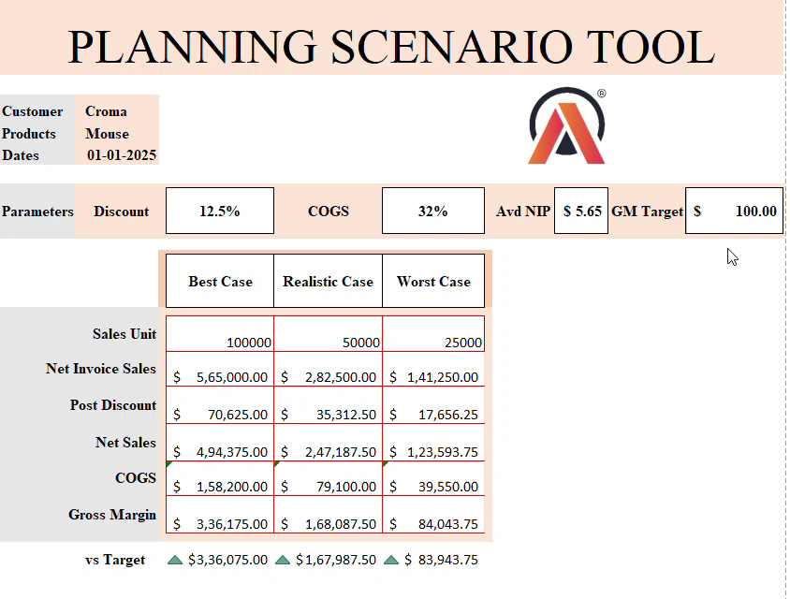
Embedded video of "Planning Scenario Tool“ :
"This video provides a quick walkthrough of the Planning Scenario Tool in action."

Slide 3
Introduction:
The Planning Scenario Tool helps businesses analyze different sales scenarios (Best Case, Realistic Case, and Worst Case).
It allows users to adjust parameters like Discount, COGS, and Gross Margin Target to find the most profitable strategy.
Problem Statement:
Businesses struggle to predict the impact of discounts on revenue.
Without proper planning, companies might lose profits or set unrealistic targets.
This tool helps in data-driven decision-making by forecasting revenue and profitability.

Slide 4
Key Features:
✅ Compare Best Case, Realistic Case, and Worst Case scenarios. ✅ Adjust Discount % dynamically to see its impact. ✅ Calculate Net Invoice Sales, COGS, and Gross Margin automatically. ✅ Determine if the business meets its profit target ($100,000 or more). ✅ Visual representation of different financial outcomes.
How it works:
🟢 Step 1: Enter product details (e.g., Mouse, Selling Price = $5) 🟢 Step 2: Input expected Sales Units for different cases 🟢 Step 3: Adjust Discount % and COGS % 🟢 Step 4: The tool calculates Net Sales, Gross Margin, and Profitability 🟢 Step 5: Compare with the Gross Margin Target ($100,000) 🟢 Step 6: Approve or reject the business strategy

Slide 5
Formula Breakdown 📊:
Metric | Formula used
Net Invoice Sales | Average NIP × Sales Unit
Post Discount | Discount % × Net Invoice Sales
Net Sales (Revenue) | Net Invoice Sales - Post Discount
COGS (Cost of Goods Sold) | Net Sales × COGS %
Gross Margin | Net Sales - COGS
vs Target | GM Target - Gross Margin

Slide 6
Conclusion & Final Thoughts 🎯:
The Planning Scenario Tool simplifies complex financial forecasting.
Helps businesses make informed decisions regarding discounts and pricing.
Provides actionable insights to ensure profitability.
A valuable tool for sales teams, finance managers, and strategists.

Slide 7
Contact & Links 🔗:
📌 GitHub Repository: Click Here
📌 LinkedIn Profile: [Click Here]
📌 Email: [tyagivishal8583@gmail.com]
"For any queries or collaboration, feel free to reach out!"
THANKS….!

